Slide 1
Cyborg
Kamal M. H. Raheem

Slide 2
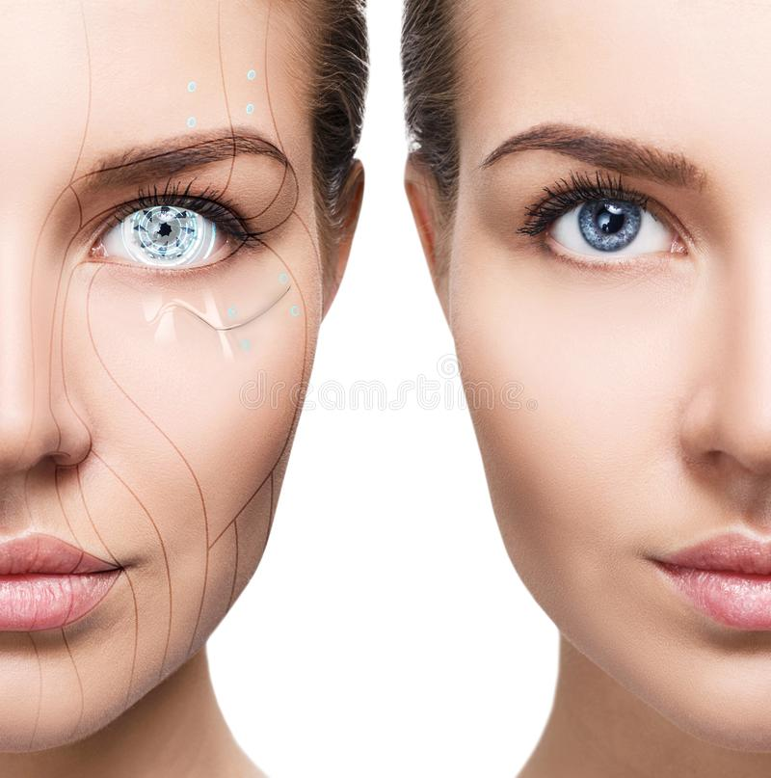

$$Contents$$
Introduction
Cyborg
History
Types of Cyborg
Cyborg and Robot
Advantages
Disadvantages
Applications

Slide 3
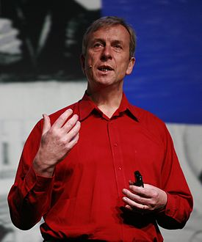
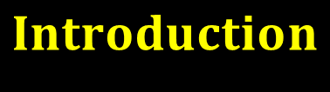
$$Introduction$$
• Kevin Warwick has taken the first steps on this path
• Machines with an Intelligence more powerful than that of humans
• It will be a robot dominated world with dire consequences for humankind

Slide 4
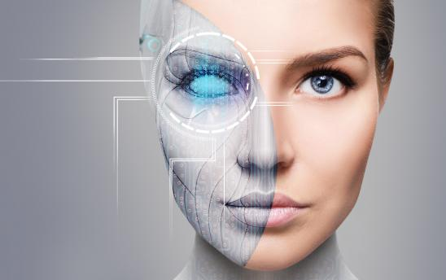

$$Cyborg$$
CYBORG is a combination between man and machine.
Used to repair or overcome physical and mental constraints.

Slide 5
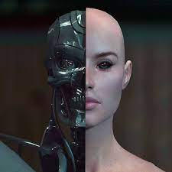
$$Cyborg$$
A portmanteau of Cybernetic and Organism
is a being with both organic and biomechatronic body parts.

Slide 6
$$Cyborg$$
Why Cyborgs ?
• Cyborgs are considered as the next step of human evolution…
A seed sized electronic implant can do many functions which reduce a lot of human effort…

Slide 7
$$Cyborg$$
Why Cyborgs ?
• Such an implant can replace credit cards, passport, visa, and can make big changes in the current lifestyle…

Slide 8
$$Cyborg$$

Slide 9

$$History$$
•The term Cyborg was coined by Manfred Clynes and Nathan Kline in 1960 to refer to their conception of an enhanced human being who could survive in extraterrestrial environments.
•In 2004 ??
•In 2010, the Cyborg Foundation became the world’s first international organization dedicated to help humans become cyborgs.

Slide 10

Types of $Cyborg$
Convenient Cyborgs
refer to any external provision of an exoskeleton for satisfying the altered fancy needs of body
Conditional Cyborgs.
includes bionic implants replanting the Lost or damaged body for the normal living in the present environment.

Slide 11
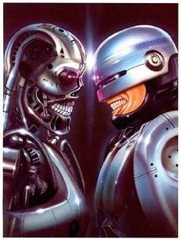
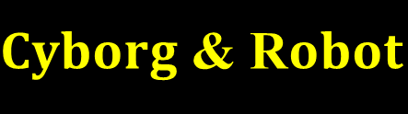
$Cyborg$& R$obot$
A robot is an automated machine while a cyborg is a combination of an organism with a machine.
Robots aren’t alive while cyborgs are.
Robots do not get tired while cyborg get tired
Robots can be simple or very complex while cyborgs very complex.

Slide 12

$Cyborg$ Advantages
  Returning Function
  Increased Strength
  Added Functionality
  Possibly Longer Lifespan
  Increased Intelligence/Computational Power/Perception

Slide 13

$Cyborg$ Disadvantages
Possible loss of humanity
Expensive
Loss of Acceptable Appearance
Likely to Die in the Creation Procedures

Slide 14
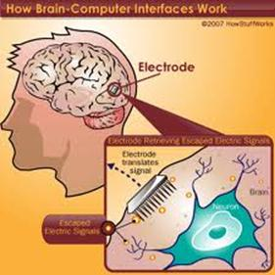
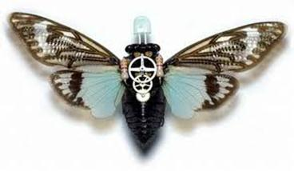
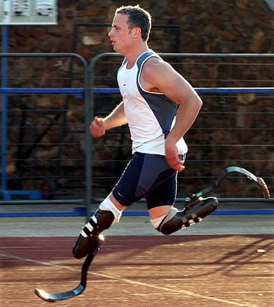

$Cyborg$ Applications
Medicine
Military
Sport

Slide 15
$Cyborg$ Applications

Slide 16
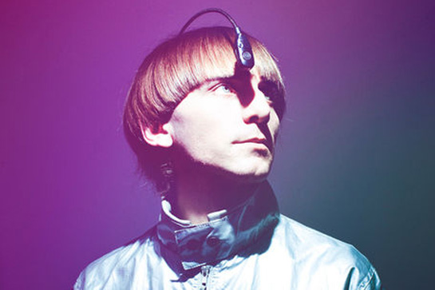
$Cyborg$ Applications
2004
First Cyborg
Neil Harbisson

Slide 17
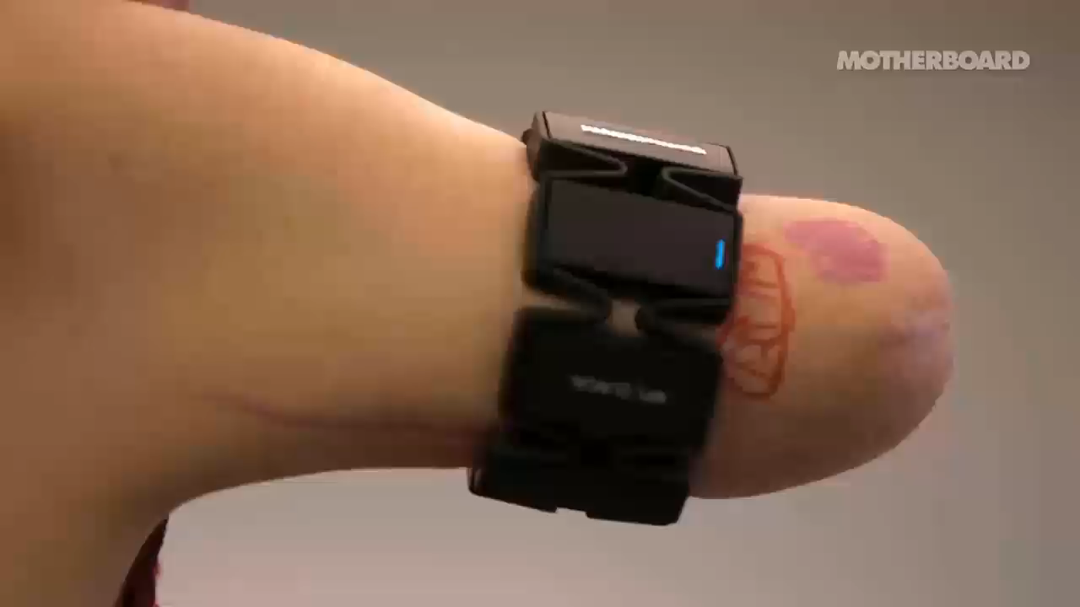
$Cyborg$ Applications

Slide 18
Thank You

